Slide 1
Trees and Binary Trees Oswald c
Become Rich
Force Others to be Poor
Rob
Banks
Stock
Fraud
The class notes are a compilation and edition from many sources. The faculty does not claim intellectual property or ownership of the lecture notes.

Slide 2

"A tree may grow a thousand feet tall, but its leaves will return to its roots."
-Chinese Proverb

Slide 3

Nature View of a Tree
leaves
branches
root

Slide 4

Computer Scientist’s View
root
leaves
branches
nodes

Slide 5
What is a Tree
Applications:
Organization charts
File systems
Programming environments
Computers”R”Us
Sales
Manufacturing
R&D
US
International
Laptops
Desktops
Europe
Asia
Canada

Slide 6
Definitions
root node
A tree is an abstract data type(abstract model of a hierarchical data structure)
one entry point, the root
Each node is either a leaf or an internal node
An internal node has 1 or more children, nodes that can be reached directly from that internal node.
The internal node is said to be the parent of its child nodes
internal nodes
leaf nodes

Slide 7
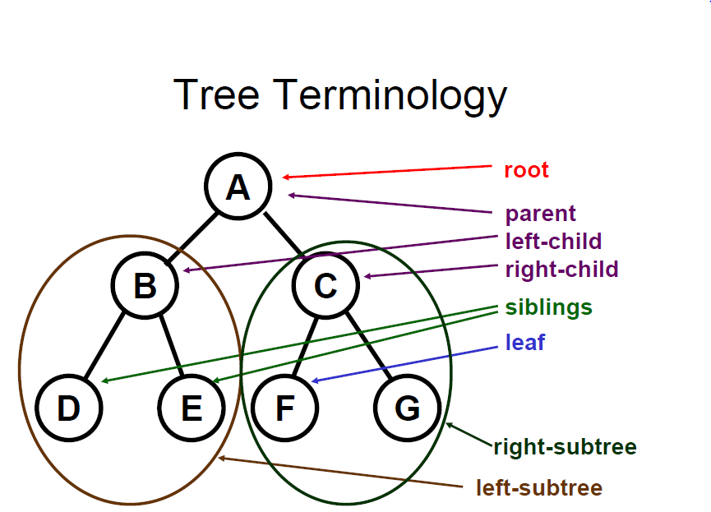
Tree Terminology
Root: node without parent (A)
Siblings: nodes share the same parent
Internal node: node with at least one child (A, B, C)
External node (leaf ): node without children (D, E,F, G)
Ancestors of a node: parent, grandparent, grand-grandparent, etc.
Descendant of a node: child, grandchild, grand-grandchild, etc.
Height of a node: length of a longest path from the node to a leaf.
Depth of a node: length of the unique path from the root to that node.
Degree of a node: the number of its children
Subtree: tree consisting of a node and its descendants
A leaf has a height of 0
The height of a tree is the height of the root of that tree

Slide 8
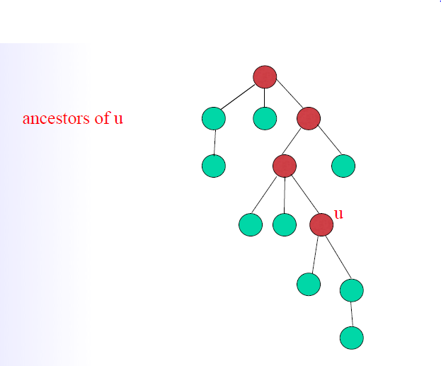
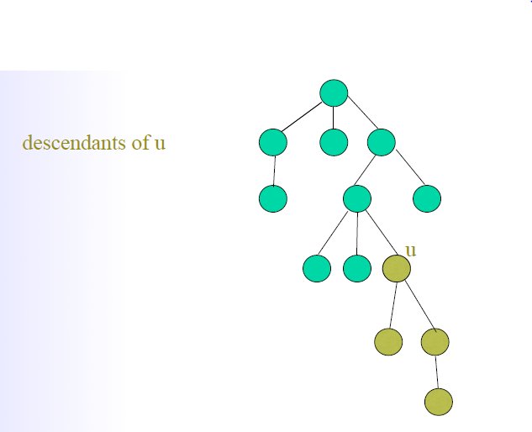
Ancestors and Descendants

Slide 9
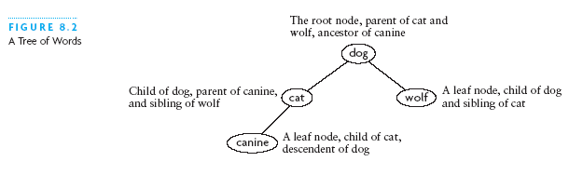
A Tree of Words
Level 0 (root)
Level 1
Level 1
Level 2

Slide 10
Tree Properties
Property Value
Number of nodes
Height of the tree
Root Node
Leaves
Internal nodes
Ancestors of H
Descendants of B
Siblings of E
Right subtree of A
Height and Depth of every node
A
B
C
D
E
F
G
H
I

Slide 11
Tree ADT
We use positions to abstract nodes
Generic methods:
integer size()
boolean isEmpty()
objectIterator elements()
positionIterator positions()
Accessor methods:
position root()
position parent(p)
positionIterator children(p)
Query methods:
boolean isInternal(p)
boolean isExternal(p)
boolean isRoot(p)
Update methods:
swapElements(p, q)
object replaceElement(p, o)
Additional update methods may be defined by data structures implementing the Tree ADT

Slide 12
Intuitive Representation of Tree Node
List Representation
( A ( B ( E ( K, L ), F ), C ( G ), D ( H ( M ), I, J ) ) )
The root comes first, followed by a list of links to sub-trees
How many link fields are needed in
such a representation?
Data
Link 1
Link 2
…
Link n

Slide 13
Trees
Every tree node:
object – useful information
children – pointers to its children
Data
Data
Φ
Φ
Data
Φ
Data
Φ
Φ
Data
Φ
Φ
Data
Φ
Φ
Data
Φ
Φ

Slide 14
A Tree Representation
A node is represented by an object storing
Element
Parent node
Sequence of children nodes
∅
B
∅
∅
A
D
F
B
A
D
F
∅
∅
C
E
C
E

Slide 15
Left Child, Right Sibling Representation LCRS
Data
Left Child
Right Sibling
A
B
C
D
E
F
G
H
I
J
K
L

Slide 16
Binary Tree
A binary tree is a tree with the following properties:
Every node has maximum 2 children.
The children of a node are an ordered pair
We call the children of an internal node left child and right child
Alternative recursive definition: a binary tree is either
a tree consisting of a single node, OR
a tree whose root has an ordered pair of children, each of which is a binary tree
Applications:
arithmetic expressions
decision processes
searching
A
B
C
D
E
F
G
H
I

Slide 17
BinaryTree ADT
The BinaryTree ADT extends the Tree ADT, i.e., it inherits all the methods of the Tree ADT
Additional methods:
position leftChild(p)
position rightChild(p)
position sibling(p)
Update methods may be defined by data structures implementing the BinaryTree ADT

Slide 18
Examples of the Binary Tree
Skewed Binary Tree
Complete Binary Tree
A
A
0
A
B
B
1
B
C
C
2
D
F
G
A full binary tree (sometimes proper binary tree or 2-tree) is a tree in which every node other than the leaves has two children.
E
D
3
A complete binary tree is a binary tree in which every level, except possibly the last, is completely filled, and all nodes are as far left as possible.
H
E
I

Slide 19
Differences Between A Tree and A Binary Tree
The subtrees of a binary tree are ordered; those of a tree are not ordered.
A
A
B
B
Are different when viewed as binary trees.
Are the same when viewed as trees.

Slide 20
General Tree v.s. Binary Tree
A general tree T is a set of one or more nodes such that T is partitioned into disjoint subsets:
A node r, the root
Sets that are general trees, called subtrees of r
A binary tree is a set T of nodes such that
T is empty, or
T is partitioned into 3 disjoint subsets:
A node r, the root
2 possibly empty sets that are binary trees, called left and right subtrees of r

Slide 21
Data Structure for Binary Trees
A node is represented by an object storing
Element
Parent node
Left child node
Right child node
∅
B
∅
∅
B
A
D
A
D
∅
∅
∅
∅
C
E
C
E

Slide 22
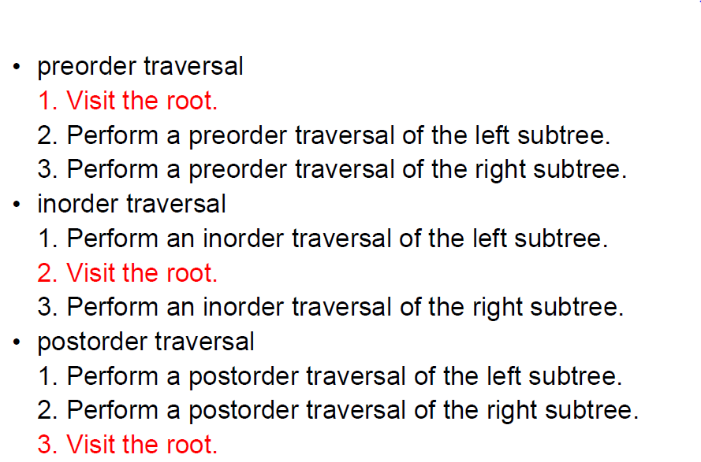
Tree Traversal
Three main methods:

Slide 23
Preorder Traversal
A traversal visits the nodes of a tree in a systematic manner
In a preorder traversal, a node is visited before its descendants
Application: print a structured document
Algorithm preOrder(v)
visit(v)
for each child w of v
preorder (w)
1
Become Rich
2
5
9
1. Motivations
2. Methods
3. Success Stories
3
4
6
7
8
1.1 Enjoy Life
1.2 Help Poor Friends
2.1 Get a CS PhD
2.2 Start a Web Site
2.3 Acquired by Google

Slide 24
Postorder Traversal
In a postorder traversal, a node is visited after its descendants
Application: compute space used by files in a directory and its subdirectories
Algorithm postOrder(v)
for each child w of v
postOrder (w)
visit(v)
9
cs16/
8
3
7
homeworks/
programs/
todo.txt 1K
1
2
4
5
6
h1c.doc 3K
h1nc.doc 2K
DDR.java 10K
Stocks.java 25K
Robot.java 20K

Slide 25
Inorder Traversal
In an inorder traversal a node is visited after its left subtree and before its right subtree
Algorithm inOrder(v)
if isInternal (v)
inOrder (leftChild (v))
visit(v)
if isInternal (v)
inOrder (rightChild (v))
6
2
8
1
4
7
9
3
5

Slide 26
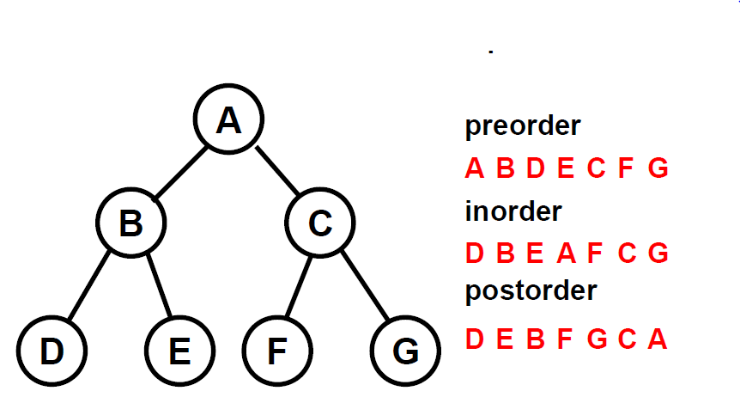
Tree Traversal – An Example

Slide 27
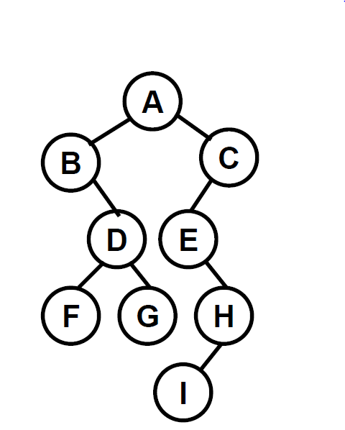
Try it out!
Find:
Inorder
Preorder and
Postorder

Slide 28
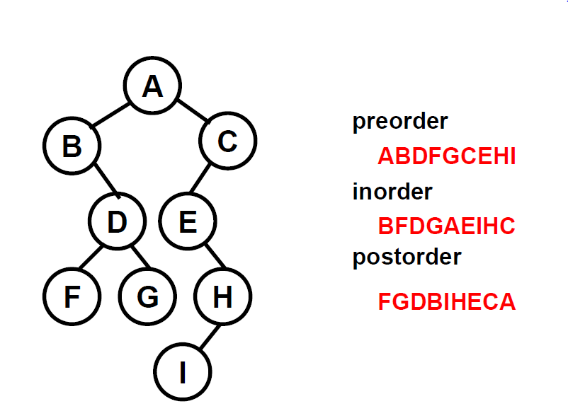
Answer

Slide 29
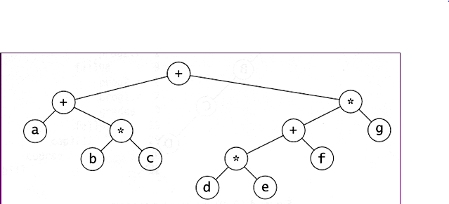
Computer the tree traversals

Slide 30
Naïve Implementations
 | unsorted array | sorted array | linked list
insert | O(n) | find + O(n) | O(1)
find | O(n) | O(log n) | O(n)
delete | find + O(1) (mark-as-deleted) | find + O(1) (mark-as-deleted) | find + O(1)

Slide 31
Arithmetic Expression Tree
Binary tree associated with an arithmetic expression
internal nodes: operators
external nodes: operands
Example: arithmetic expression tree for the expression (2 × (a − 1) + (3 × b))
+
×
×
2
−
3
b
a
1

Slide 32
Print Arithmetic Expressions
Specialization of an inorder traversal
print operand or operator when visiting node
print “(“ before traversing left subtree
print “)“ after traversing right subtree
Algorithm inOrder (v)
if isInternal (v){ print(“(’’)
inOrder (leftChild (v))}
print(v.element ())
if isInternal (v){
inOrder (rightChild (v))
print (“)’’)}
+
×
×
2
−
3
b
((2 × (a − 1)) + (3 × b))
a
1

Slide 33
Evaluate Arithmetic Expressions
recursive method returning the value of a subtree
when visiting an internal node, combine the values of the subtrees
Algorithm evalExpr(v)
if isExternal (v)
return v.element ()
else
x ← evalExpr(leftChild (v))
y ← evalExpr(rightChild (v))
◊ ← operator stored at v
return x ◊ y
+
×
×
2
−
3
2
5
1

Slide 34
Arithmetic Expression Using BT
+
inorder traversal
A / B * C * D + E
infix expression
preorder traversal
+ * * / A B C D E
prefix expression
postorder traversal
A B / C * D * E +
postfix expression
level order traversal
+ * E * D / C A B
*
E
*
D
/
C
A
B

Slide 35
Decision Tree
Binary tree associated with a decision process
internal nodes: questions with yes/no answer
external nodes: decisions
Example: dining decision
Want a fast meal?
Yes
No
How about coffee?
On expense account?
Yes
No
Yes
No
Starbucks
Spike’s
Al Forno
Café Paragon

Slide 36
Maximum Number of Nodes in a Binary Tree
The maximum number of nodes on depth i of a binary tree is 2^{i}, i>=0.
The maximum nubmer of nodes in a binary tree of height k is 2^{k+1}-1, k>=0.
Prove by induction.

Slide 37
Full Binary Tree
A full binary tree of a given height k has 2^{k+1}–1 nodes.
Height 3 full binary tree.

Slide 38
Labeling Nodes In A Full Binary Tree
Label the nodes 1 through 2^{k+1} – 1.
Label by levels from top to bottom.
Within a level, label from left to right.
1
2
3
4
5
6
7
8
9
10
11
12
13
14
15

Slide 39
Node Number Properties
1
2
3
4
5
6
7
8
9
10
11
12
13
14
15
Parent of node i is node i / 2, unless i = 1.
Node 1 is the root and has no parent.

Slide 40
Node Number Properties
1
2
3
4
5
6
7
8
9
10
11
12
13
14
15
Left child of node i is node 2i, unless 2i > n, where n is the number of nodes.
If 2i > n, node i has no left child.

Slide 41
Node Number Properties
1
2
3
4
5
6
7
8
9
10
11
12
13
14
15
Right child of node i is node 2i+1, unless 2i+1 > n, where n is the number of nodes.
If 2i+1 > n, node i has no right child.

